Slide 1
BSBWHS304
Participate effectively in WHS communication and consultation processes

Slide 2
Facts
http://www.safeworkaustralia.gov.au worker-fatalities

Slide 3
Direct Costs
These include:
Depending on the company, sick and compensation leave, etc, the worker may experience a loss of income
If the injury or illness is serious enough, there is a real possibility that the worker may not return to work
Doctor and hospital or medical bills are sure to be of major concern to the worker

Slide 4
Indirect Costs
These include:
Suffering that is endured by the worker's family
The employer pays for missed work days. Work is not performed yet the employer still has to pay salaries and wages
Compensation payments and medical expenses
Lower morale or negative attitudes by other workers
Loss in productivity
Repair to damaged machinery or replacement costs
Retraining or replacing workers

Slide 5
Why Bother?
Welfare of the employee and their family -maintain it and enhance it
Community expectations – show responsibility
Community costs - reduce them
Business costs - contain them
Legal requirements - comply with them

Slide 6
Legislation
Where to find information
Sources can be internal or external
Who does what under the legislation
Person Conducting a Business or Undertaking (PCBU)
Officer
Worker
Other Persons

Slide 7
WHS Framework
NUL (National Uniform Legislation)
Act
The WHS (NUL) Act 2011 describes how to provide health and safety in NT workplaces. Everything in the Act must be followed
Regulations
The WHS (NUL) Regulations 2011 are made under the Act and set out the general principles and practical steps that should be followed in order to prevent injury and illness at work. Everything in the Regulations is law and must be followed
Approved Codes of Practice
These give you practical guidance on how to comply with legal requirements of specific Regulations and should be used in addition to the Act and Regulations. You are obliged to follow gazetted Approved Codes of Practice unless you can apply another solution that is as good or better
Guidelines, Australian/Industry Standards
Guidelines, standards and other information products provide general information about aspects of the Act, Regulations or specific hazards

Slide 8
Providing WHS Advice
At times, individuals and parties need advice about what they are legally required to do
They will also need to know about the function and powers of the regulator
The regulator in the Northern Territory is NT WorkSafe

Slide 9
CDU
Charles Darwin University is a PCBU
Who are the Officers?
Vice Chancellor
Members of the university council

Slide 10
Consultation
By law, a PCBU must, so far as is reasonably practicable, consult with workers who carry out work for their business or undertaking who are, or are likely to be, directly affected by a health and safety matter.
The duty is qualified by so far as is reasonably practicable, which means that the circumstances in each case, including the urgency of the health and safety issue and the seriousness of the risk, will be relevant when determining the level of consultation that is required.

Slide 11
Consultation Processes
Two common processes are the appointment of Health and Safety Representatives (HSRs) and establishing Health and Safety Committees (HSCs)

Slide 12
Barriers
A barrier is anything that restrains or obstructs a process. Ineffective health and safety consultation and participation processes obstruct the sharing of health and safety information between PCBUs and workers. They limit the opportunities for workers to contribute to identifying and successfully solving health and safety problems that affect them at work. This can lead to unmotivated workers who feel that their knowledge and experience is not valued by the organisation.

Slide 13
Improving the Process
Identify barriers to the consultation and participation processes such as:
Lack of commitment
Paying lip service to consultation
Lack of understanding about responsibilities
Lack of support for HSRs
Language and literacy levels
Shiftworkers

Slide 14
Identifying Barriers
Personal observation
Interviews
Feedback forms
Exit interviews
Suggestions from staff
Meetings and forums
Analysis of statistical data

Slide 15
Information Sources
Accident, injury & illness reports, records & statistics
Workplace hazard & risk assessments
Safety Data Sheets (SDS)
Safe Work Australia
Regulatory bodies
WorkCover
Internet

Slide 16
Hazard Identification Steps
Observation
Records
Meetings
Inspection

Slide 17
Definitions
Hazard
Any source (occurrence or incident) that has the potential to harm life, health, property or the environment and that causes or contributes to people, property or environmental damage
Risk
The chance or likelihood that harm will occur as a result of a hazard

Slide 18
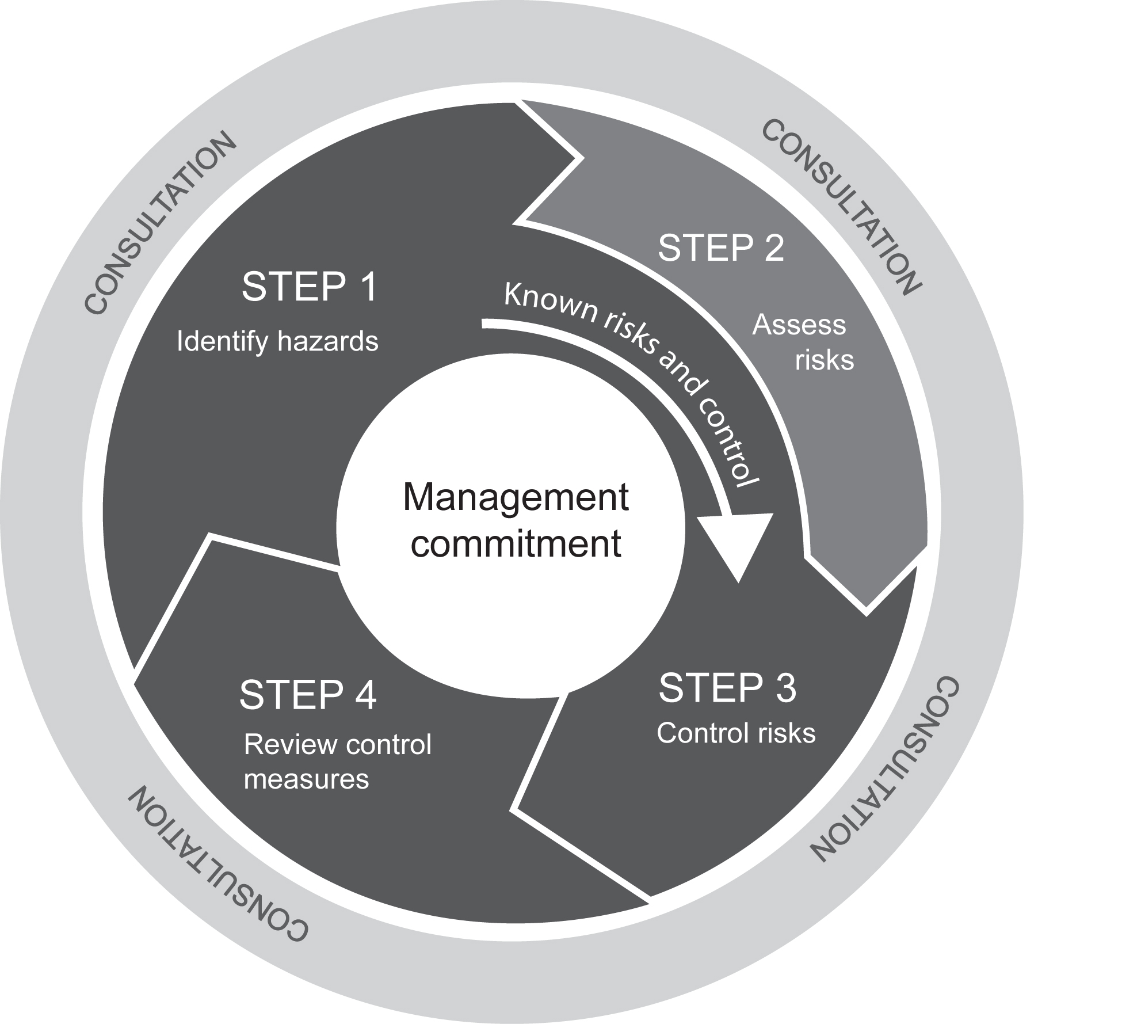
The Process

Slide 19
Hazard identification
Providing advice
All staff need information about workplace hazards and how they may impact on them or others
Observation and inspection is one method of identifying hazards
Document what you find
Hazard registers

Slide 20
Risk Assessment
When conducting a risk assessment, consider:
The severity of the potential injury
The probability or likelihood that the injury will occur
Hazard/risk registers
These can be combined

Slide 21
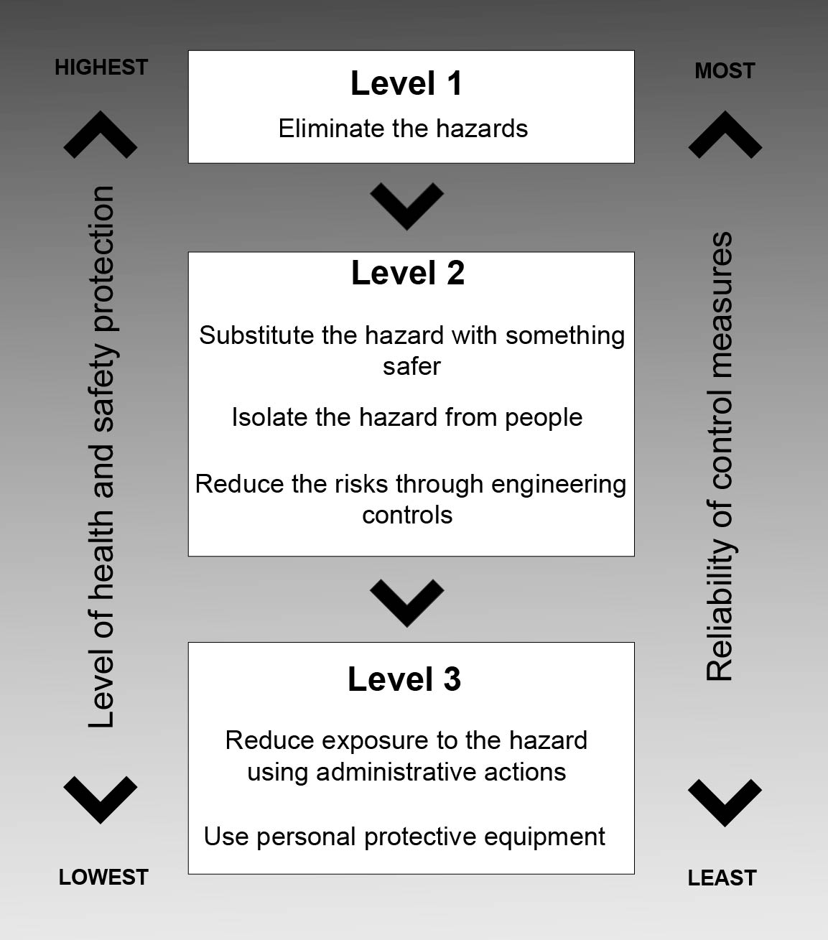
Hierarchy of Controls

Slide 22
Controls
Risk control plan
Prioritise the hazards and decide what controls to use
Evaluation
Have we achieved what we planned?
Is it still workable?
Have we created any new hazards?
All control measures should include a review date to ensure continual improvement

Slide 23
Communicating WHS
Meetings
Training
Notice boards
Newsletters
Email
Intranet

Slide 24


