Slide 1
BSBSUS401 Implement and monitor environmentally Sustainable Work Practices

Slide 2
What is Sustainability?
Sustainability is the process of meeting the resource needs of the present without compromising the needs of future generations. To this end, business sustainability is the term given to the strategies surrounding meeting the resource and staffing needs of the business without again jeopardising the needs of the future.

Slide 3
Legislation
Environmental Protection and Biodiversity Conservation Act (1999)
Plus a range of other national, state and territory environmental, historical and cultural acts.

Slide 4
www.ntepa.nt.gov.au/
The NT EPA is responsible for providing advice on the environmental impacts of development proposals and policy advice and regulatory services to provide for effective waste management, pollution control and sustainable practices

Slide 5
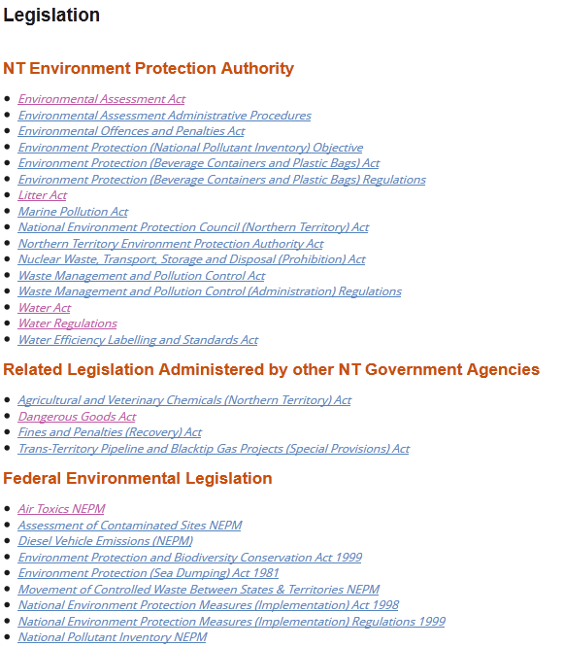
NT Legislation
www.ntepa.nt.gov.au/about-nt-epa/legislation

Slide 6
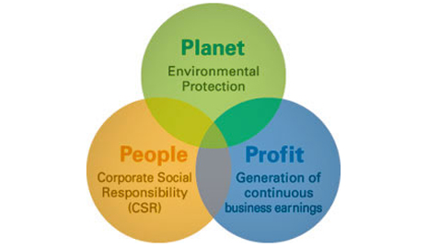
Business Sustainability
This effect of economic, environmental, social and equitable considerations is quite often described as a triple bottom line principle being:
Profit
People
Planet

Slide 7

Resources used in order to complete your daily tasks
Did you have a shower this morning?
How did you get to work today?
What are you having for lunch?
Do you use a computer at work?
What did you throw out today?

Slide 8
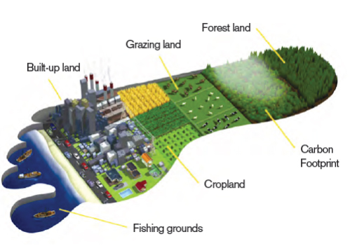
Renewable V Non Renewable
Some resources are replaced naturally and can be used again:
Oxygen
Fresh water
Solar energy
Timber
Biomass
They may become non-renewable resources if they are used faster than nature can replace them.

Slide 9
Earth overshoot day August 13th 2015
Since the dawn of civilization, the planet replenished its resources faster than humans consumed them. However in 1970 we crossed an invisible boundary.
Since then, the gap between our rate of consumption and the planet's rate of regeneration has widened from a crevice to a chasm. The first Earth Overshoot Day fell in late December 1970. This year, it falls on August 13.

Slide 10
Environmental hazard identification procedures or audits consist of a number of steps:

Slide 11
Barriers to Sustainability
• Low level of commitment to sustainability processes
• Cost – e.g. Purchasing the cheapest consumables regardless of performance
• Shortcuts taken due to workplace requirements
• Lack of training and supervision
• Lack of/poor consultation with employees
• Lack of understanding of expectations and needs
• Invalid signage
• Lack of care by employers and/or employees
• Staff disinterest

Slide 12
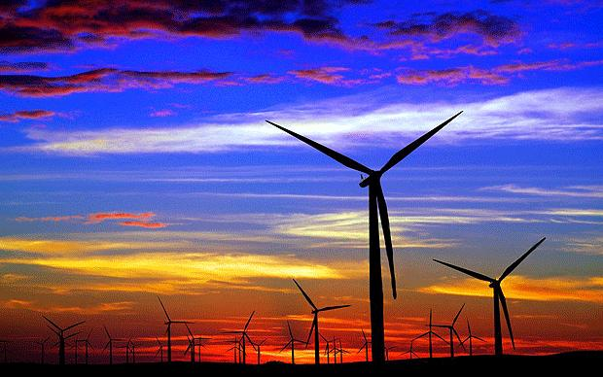
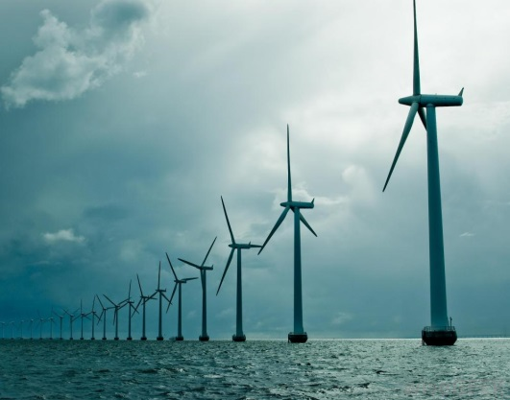
Tracking resource usage
How can we track and monitor resource use?
Sustainability checklists to identify usage
Check Usage Records-establish a baseline

Slide 13
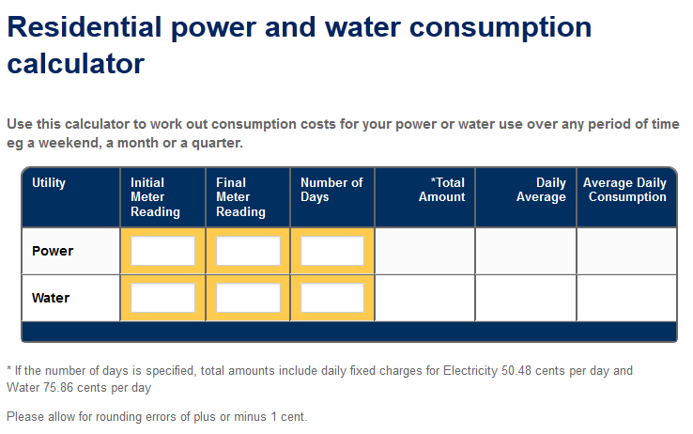
PowerWater – Calculator
www.powerwater.com.au/customers/residential_consumption_calculator

Slide 14
Comparing your bills
Always compare consumption for the same period in the previous year.
For example, January to April 2015 compared with January to April 2016.
Weather affects how much electricity we use, so comparing the same period each year will give you a more accurate comparison.
www.powerwater.com.au/customers/my_account/bill

Slide 15
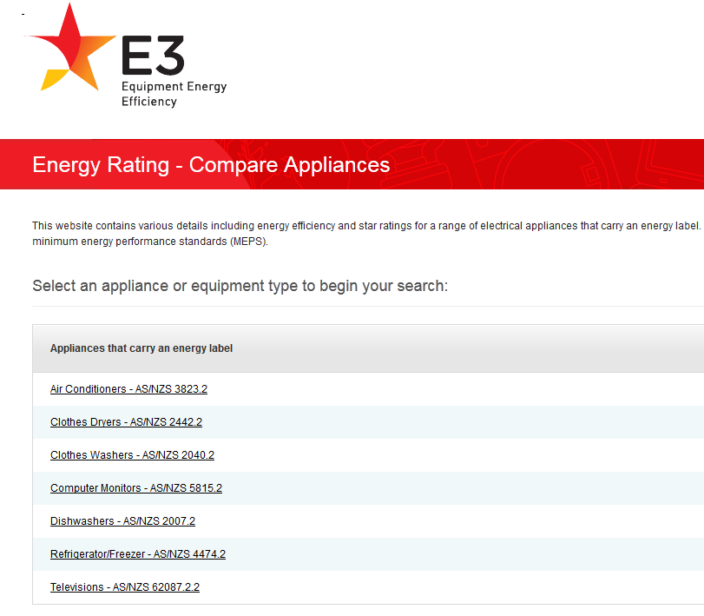
Comparing Energy Efficiency
reg.energyrating.gov.au/comparator/product_types/

Slide 16
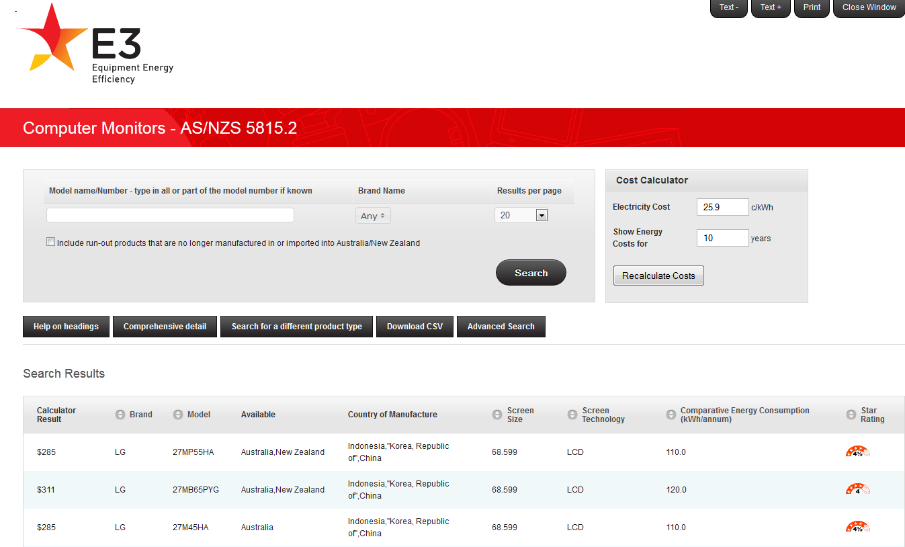
Comparing Energy Efficiency costs
http://reg.energyrating.gov.au/comparator/product_types/74/search/

Slide 17
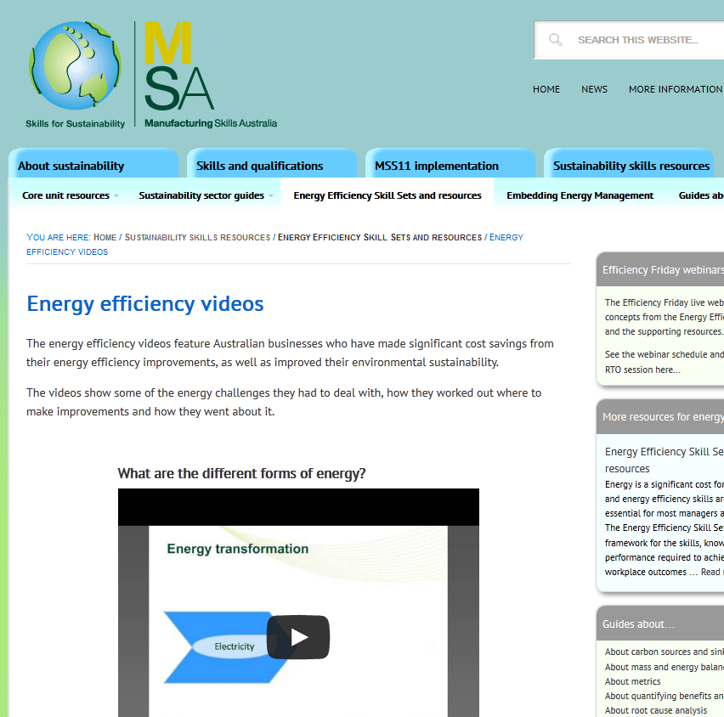
Energy efficiency videos
http://sustainabilityskills.net.au/sustainability-skills-resources/energy-efficiency-skill-set-resources/energy-efficiency-videos/

Slide 18
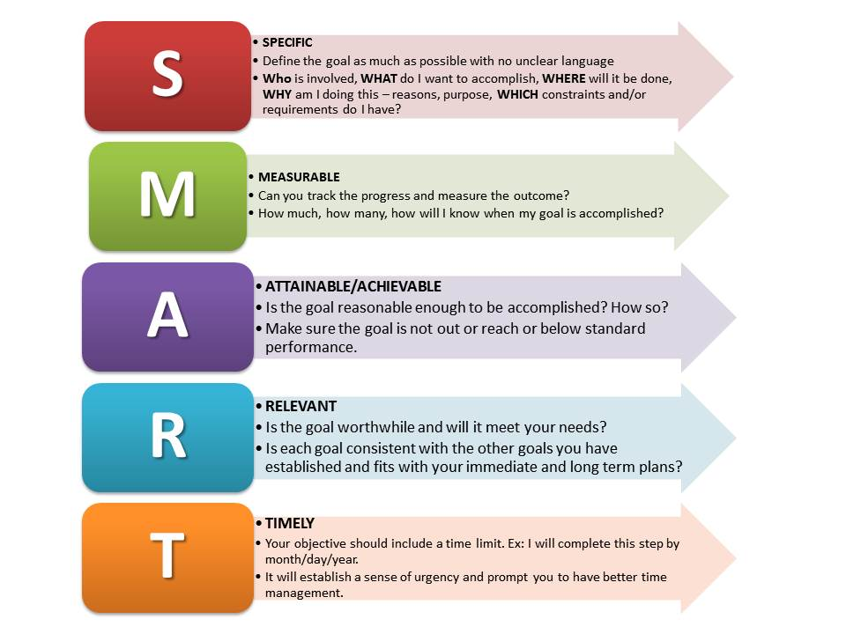
Measuring Goals and Targets Ensure they meet SMART criteria
SMART goals are goals that are:

Slide 19
Benefits of improving resource efficiency
increased cost saving
process efficiency
improved occupational health and safety management
enhanced shareholder relations
improved reputation.

Slide 20
Additional resources and exercises
http://www.wwf.org.au/our_work/people_and_the_environment/human_footprint/footprint_calculator/
http://www.epa.vic.gov.au/business-and-industry/lower-your-impact/resource-efficiency
http://www.youtube.com/watch?v=nJliYqEXfeI youtube-a story of sustainability
http://www.businesschamber.com.au/NSWBC/media/Misc/Policy%20Documents/Sustainability-Toolkit-Offices.pdf for efficiency/sustainability analysis forms
http://environment.gov.au/epbc/compliance-and-enforcement/report-a-breach-breach reporting forms

